Slide 1
-Distance -距离
Ray Jane Xuan

Slide 2
· 作业简述 · Description of project
本组作业的题目为：距离
The topic of our group assignment is distance.
距离是指空间或者时间上相隔或者间隔的长度，但也可以形容认识感情等方面的差距。简而言之这是个可以同时表达抽象与具体的主题。
Distance is defined to describe the spatial or temporal amount between two things, or a situation in which two people do not have a close friendly relationship. To be short, it could be an abstract topic or concrete topic.
我们想通过分析得到的数据，用一种更加特别的方式来表现除具体数据这种理性的表达方式以外，更加清晰有趣的对于距离的数据可视化模型。
We want to analyze the data and use a more specific way to represent the data visualization model for distance, which is more clear and interesting than the rational expression of specific data.

Slide 3
通过问卷调查的形式来收集数据，并将这些数据进行整理后，通过模型的形式表现出来。
We collect data through the questionnaire. After sorting the data, we visualize it by making a model.
问卷包括以下四个问题：
1、你认为离你最遥远的地方是哪里？Where do you think is the farthest place from you?
2、你认为与你最接近的地方是哪里？What do you think is the closest place to you?
3、你最想去的地方是哪里？Where do you want to go most?
4、你最想远离的地方是哪里？Where do you want to stay away from most?
（以上问题的答案均为准确的地点）

Slide 4
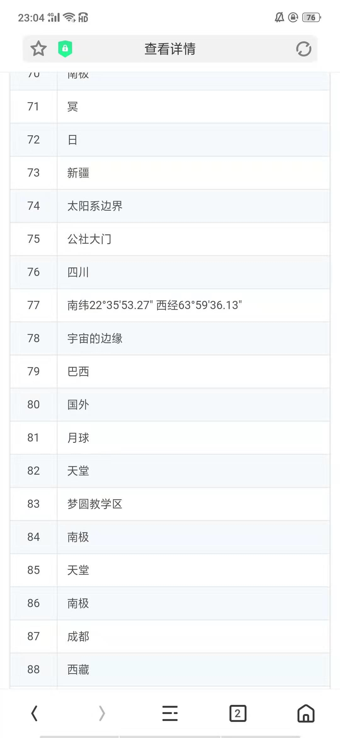
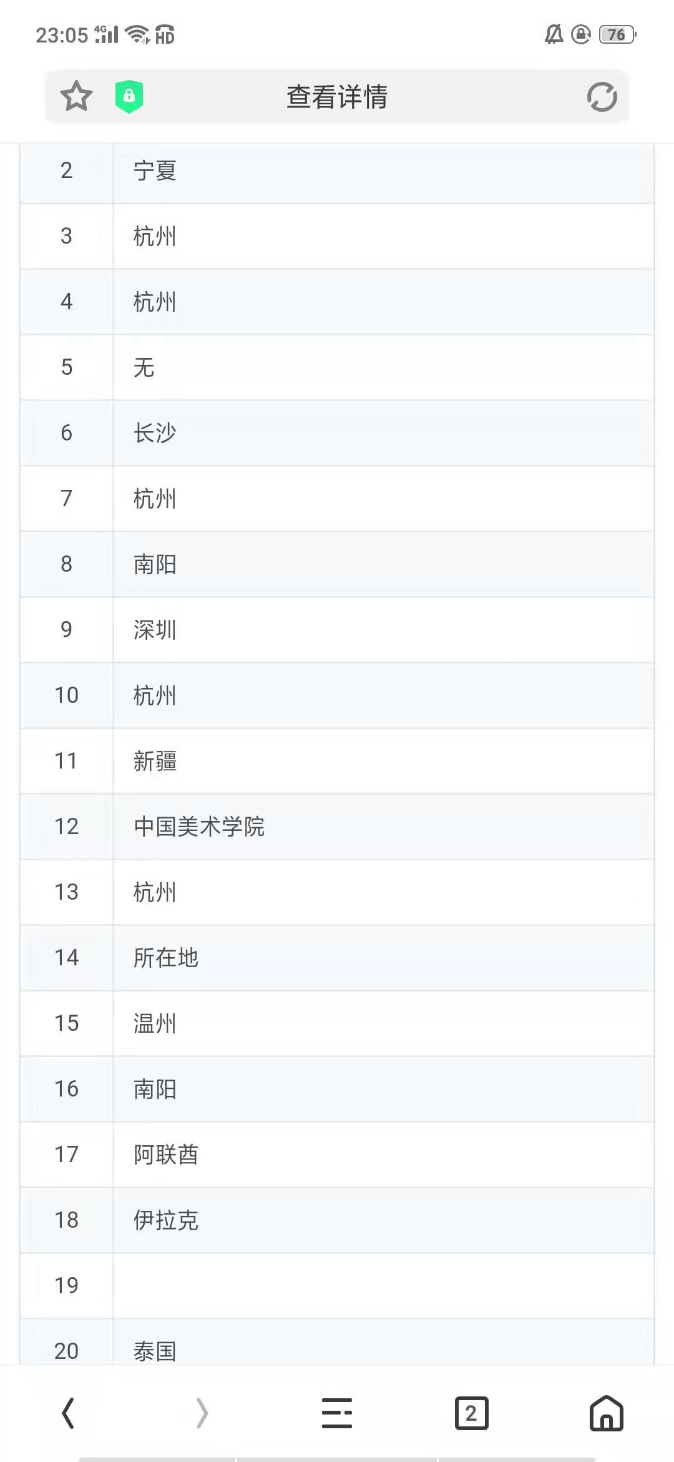

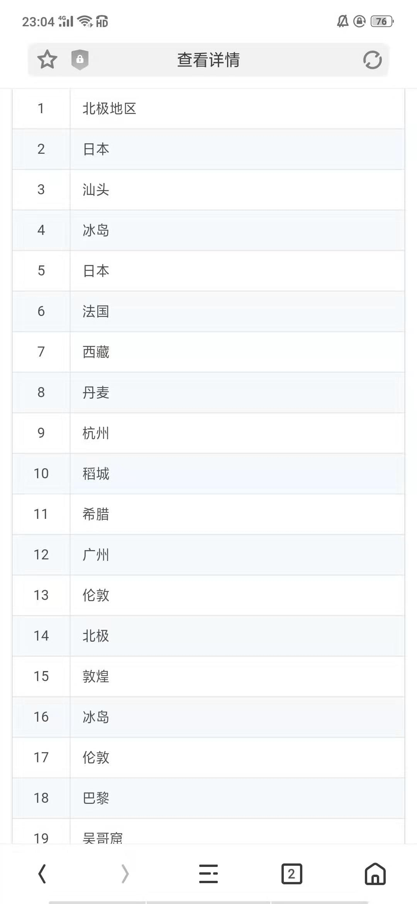
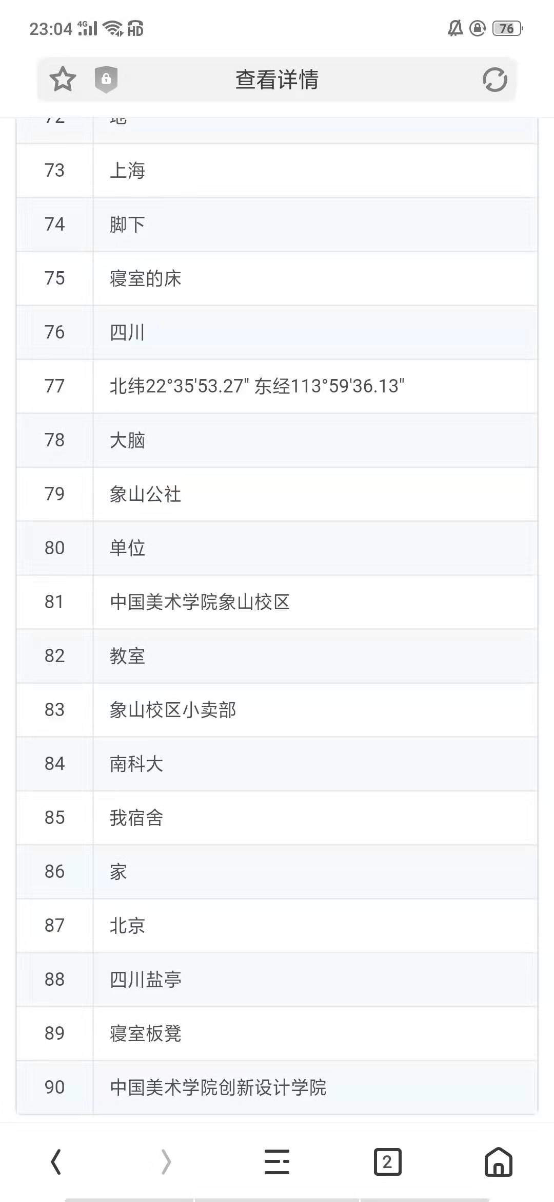
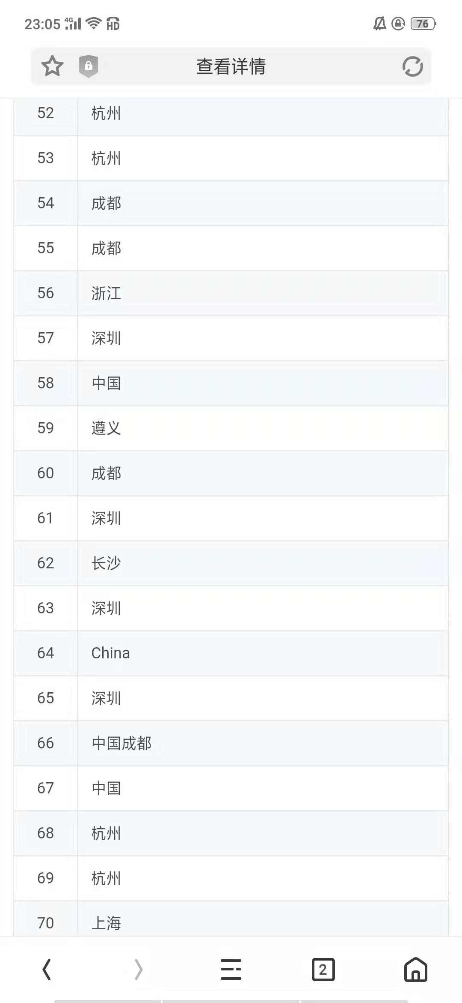
Notes:
数据截图

Slide 5
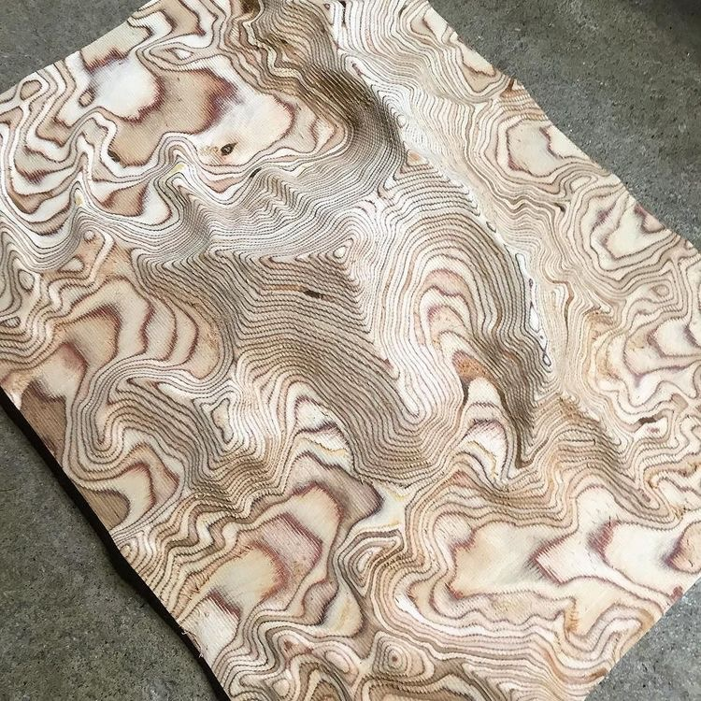


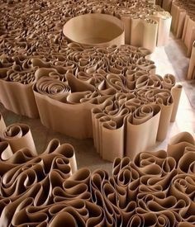
Notes:
pin

Slide 6
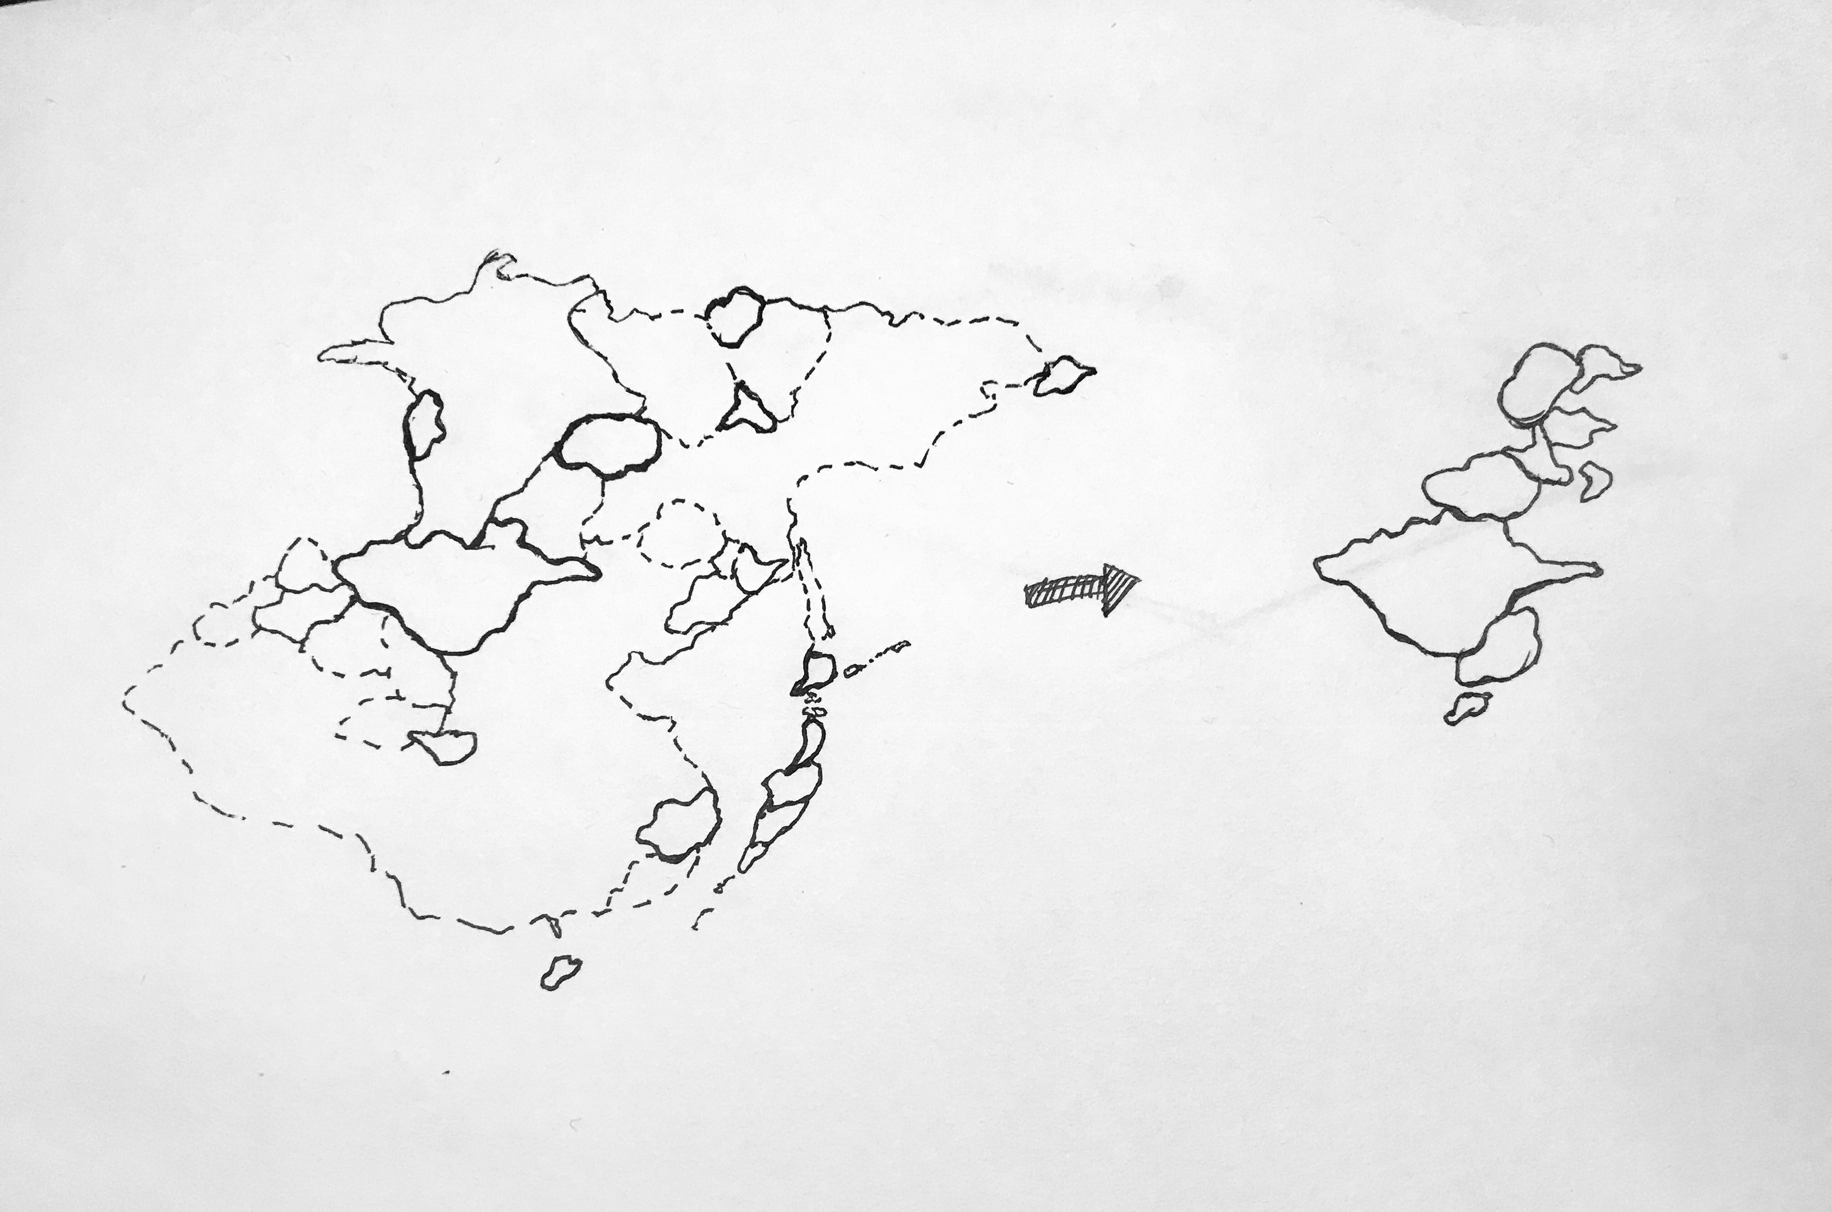
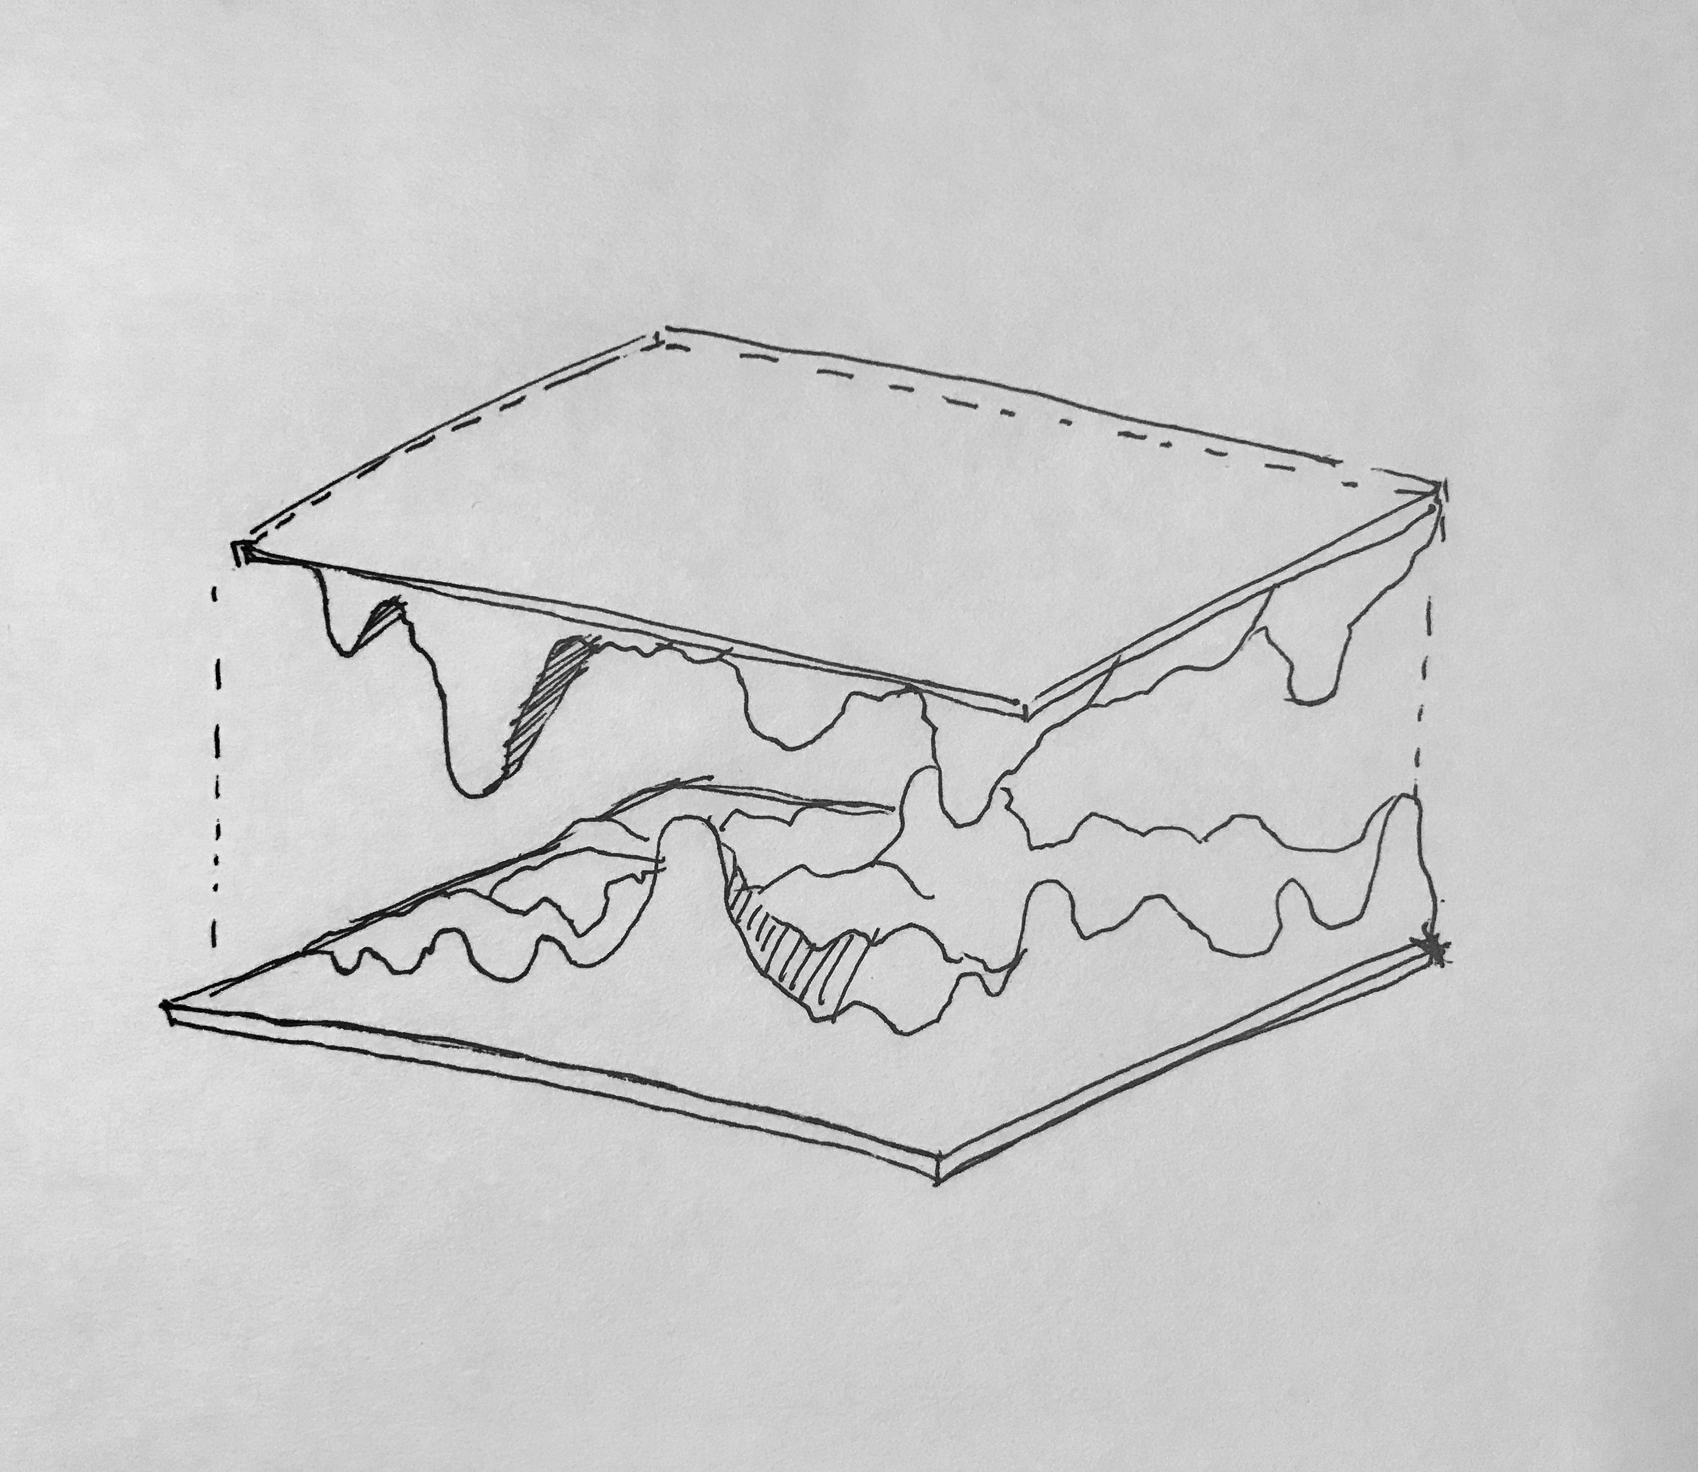
1.2x1.2
Notes:
草图 方案

Slide 7
计划 Schedule
6.18-6.19 数据整理分析 Data collecting and analyzing
6.20-6.23 材料准备与尝试 Preparing for materials and attempt
6.24-6.27 模型制作 Make model
Notes:
计划

Slide 8
Thank you
Notes:
thank

